Slide 1
Named Entity Recognition
19 March 2018

Slide 2
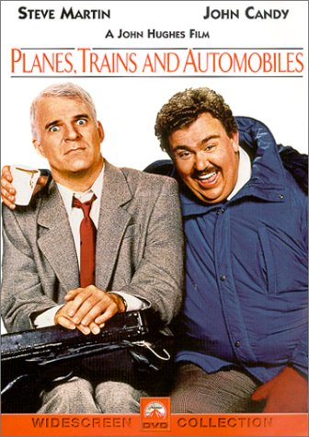
Named Entity
anything that can be referred to with a proper name
People (PER): Individuals, fiction characters, …
Organization (ORG): Companies, Agencies, …
Location (LOC): Physical extents, mountain ranges, seas, ….
Geo-political entity (GPE): Countries, states, …
Facility (FAC): Bridges, airports, buildings
Vehicles (VEH): Planes, trains and automobiles

Slide 3
Goal of NER:
Turing is often considered to be the father of modern computer science
NER: identifying Turing is a Person (PER)

Slide 4
Generic NER
focuses on the: person, location and organization
specialized applications:
weapons
nano-particle characteristics
works of art
proteins
genes

Slide 5
Extend NER
The notion of NER is commonly extended to include things that are not entities per se
Temporal expressions
dates, times, named events
Numerical expressions
Measurements, prices, counts

Slide 6
Example of annotated NER text
Citing high fuel prices, [ORG United Airlines] said [TIME Friday] it has increased fares by [MONEY $6] per round trip on flights to some cities also served by lower cost carriers. [ORG American Airlines], a unit of [ORG AMR Corp.], immediately matched the move, spokesman [PER Tim Wagner] said, a unit of [ORG UAL Corp.], said the increase took effect [TIME Thursday] and applies to most routes where it competes against discount carriers, such as [LOC Chicago] to [LOC Dallas] and [LOC Denver] to [LOC San Francisco].

Slide 7
Text contains
Citing high fuel prices, [ORG United Airlines] said [TIME Friday] it has increased fares by [MONEY $6] per round trip on flights to some cities also served by lower cost carriers. [ORG American Airlines], a unit of [ORG AMR Corp.], immediately matched the move, spokesman [PER Tim Wagner] said, a unit of [ORG UAL Corp.], said the increase took effect [TIME Thursday] and applies to most routes where it competes against discount carriers, such as [LOC Chicago] to [LOC Dallas] and [LOC Denver] to [LOC San Francisco].
13 mentions
5 organizations (ORG)
4 locations (LOC)
2 times (TIME)
1 person (PER)
1 money (MONEY)

Slide 8
Ambiguity in NER
Two types of ambiguity
the mention can refer to different entities of the same type
JFK could refer to the former president or his son
the mention can refer to more than one entity
JFK could be a person (PER) or an airport (LOC)

Slide 9
NER as sequence labeling
Words Label
American Borg
Airlines Iorg
, O
a O
unit O
of O
AMR Borg
Corp. Iorg
, O
immediately O
matched O
the O
move O
, O
spokesman O
Tim Bper
Wagner Iper
said O
. O
Standard approach to NER:
word-by-word labeling task
classifiers are trained to label the tokens in a text with tags that indicate the presence of a particular kind of name entity
[ORG American Airlines], a unit of [ORG AMR Corp.], immediately matched the move, spokesman [PER Time Wagner] said.

Slide 10
Supervised learning NER System
Training
data
Supervised Learning algorithm of choice
(e.g. Naïve Bayes)
annotated sentence
sentence

Slide 11
Supervised learning NER System
We make it sound like the NER recognizes all possible entities in the sentence.
Actuality:
one classifier per entity
So if we wanted to tag the sentence with persons, organizations and locations, we would need a classifier for each entity type
Training
data
tagged with
ORG, PER and LOC
ORG Classifier
PER Classifier
LOC Classifier
annotated sentence
sentence

Slide 12
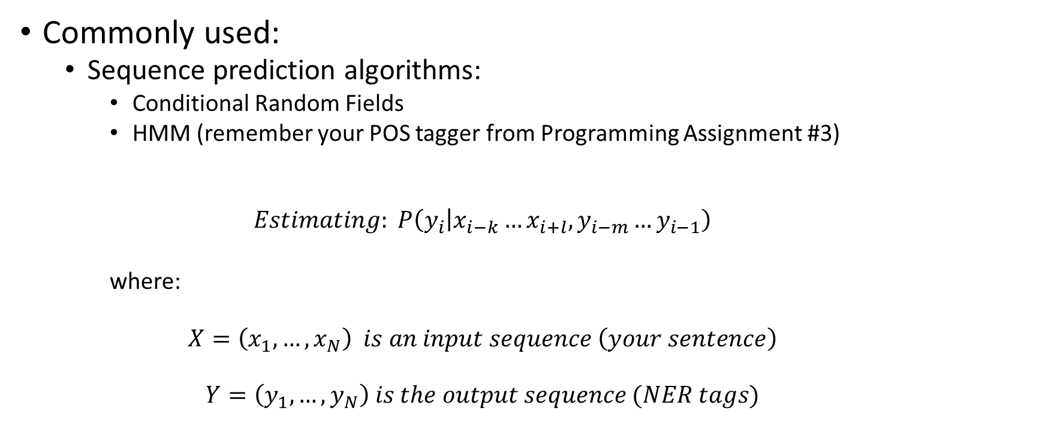
Supervised Learning Algorithms
Commonly used:
Sequence prediction algorithms:
Conditional Random Fields
HMM (remember your POS tagger from Programming Assignment #3)
$$Estimating: P\left(y_{i} | x_{i−k}…x_{i+l}, y_{i−m}…y_{i−1}\right)$$
where:
$$X=\left(x_{1}, …, x_{N}\right) is an input sequence \left(your sentence\right)$$
$$Y=\left(y_{1}, …, y_{N}\right) is the output sequence (NER tags)$$

Slide 13
Features
Orthographic
Morphological
Lexical
Syntactic
Semantic
Predictions
Triggers

Slide 14
Orthographic
initial capital letter
all capital letters
roman number
acronym
single character
all digits
contains digits
contains hyphen
etc….

Slide 15
Example of why this would be useful?
Usually have capital letter
Not when on twitter but more for news articles

Slide 16
Morphological
suffix
prefix

Slide 17
Example of why this would be useful?
Inc
Chemicals

Slide 18
Lexical
Words Label
American Borg
Airlines Iorg
, O
a O
unit O
of O
AMR Borg
Corp. Iorg
, O
immediately O
matched O
the O
move O
, O
spokesman O
Tim Bper
Wagner Iper
said O
. O
current word
contextual
words surrounding the current word

Slide 19
Example of why this would be useful?
Can provide additional information
Jfk – person or airport

Slide 20
Syntactic
Current words POS
Contextual
POS of surrounding word
Patterns:
DET NN NN
Part of a term

Slide 21
Example of why this would be useful?
If we see Verb its not a person/etc.

Slide 22
Semantic
Current words
concept from a taxonomy (e.g. WordNet)
semantic group or type
Contextual
surrounding words semantic group or concept

Slide 23
Example of why this would be useful?

Slide 24
Predictions
Left Predications
the tag predicated of the previous word in the current classification

Slide 25
Example of why this would be useful?

Slide 26
Triggers
Trigger words
for person (Mr., Mrs., Dr.)
for location (city, street, avenue)
for organizations (Inc, Co., Ltd.)
Gazetteers
names of cities, countries, villages, streets
names of organizations and companies
census
people’s first names
people’s last names

Slide 27
Example of why this would be useful?

Slide 28
Gazeteers
Where do these Gazeteers come from:
Previously:
Census data
Lists of companies
Also: Wikipedia
Artwork: novels, books, paintings, operas, plays
Named Objects: aircraft tanks, rifles, weapons
Events: playoffs, championships, races

Slide 29
Example of why this would be useful?

Slide 30
Apache OpenNLP
https://opennlp.apache.org
NameFinder module (OpenNLP NER)
https://opennlp.apache.org/docs/1.8.4/manual/opennlp.html

Slide 31
API and command line
Modules
command line
API
Fully extendable
use new training
extend features

Slide 32
Download and install
https://opennlp.apache.org/cgi-bin/download.cgi

Slide 33
Get OpenNLP NER modules
http://opennlp.sourceforge.net/models-1.5/
person: en-ner-person.bin
organization: en-ner-organization.bin
location: en-ner-location.bin
Developed using the CoNLL 2003 shared task data. Subset of the Reuters 1996 news corpus annotated with four entity types (PER, ORG, LOC, MISC).

Slide 34
Run the NameFinder module
$ ./opennlp TokenNameFinder en-ner-person.bin
copy and paste the example sentences into the STDIN:
Pierre Vinken , 61 years old , will join the board as a nonexecutive director Nov. 29 .
Mr . Vinken is chairman of Elsevier N.V. , the Dutch publishing group .
Rudolph Agnew , 55 years old and former chairman of Consolidated Gold Fields PLC , was named a director of this British industrial conglomerate .

Slide 35
Tokenizer
Notice:
NameFinder requires the sentence to be split into individual tokens
Pierre Vinken , 61 years old , will join the board as a nonexecutive director Nov. 29 .
Mr . Vinken is chairman of Elsevier N.V. , the Dutch publishing group .
Rudolph Agnew , 55 years old and former chairman of Consolidated Gold Fields PLC , was named a director of this British industrial conglomerate .

Slide 36
Tokenzier
OpenNLP has a tokenizer: TokenizerME
Download: en-token.bin module
./opennlp TokenizerME en-token.bin
Pierre Vinken, 61 years old, will join the board as a nonexecutive director Nov. 29.
Mr. Vinken is chairman of Elsevier N.V., the Dutch publishing group.
Rudolph Agnew, 55 years old and former chairman of Consolidated Gold Fields PLC, was named a director of this British industrial conglomerate.

Slide 37
Sentence Splitter
OpenNLP has a sentence splitter: SentenceDetector
Download: en-sent.bin module
./opennlp SentenceDetector en-sent.bin
Pierre Vinken, 61 years old, will join the board as a nonexecutive director Nov. 29. Mr. Vinken is chairman of Elsevier N.V., the Dutch publishing group. Rudolph Agnew, 55 years old and former chairman of Consolidated Gold Fields PLC, was named a director of this British industrial conglomerate.

Slide 38
Linking the two together
./opennlp TokenizerME en-token.bin < input.txt |
./opennlp TokenNameFinder en-ner-person.bin
where input.txt contains your sentence

